Slide 1

GEIT 3351 - Principles of Software Engineering
PMU Bank of Clothes
Online Website for Donation Management
Spring 2025-2026 Course Project

Slide 2

PART 01
Project Overview

Slide 3


INTRODUCTION & PURPOSE
Bridging the Gap
The PMU Bank of Clothes is a centralized platform designed to facilitate the collection and distribution of clothing within the university community.
By digitizing the process, we provide an efficient, secure, and transparent way for donors to give and students to receive what they need.

Slide 4
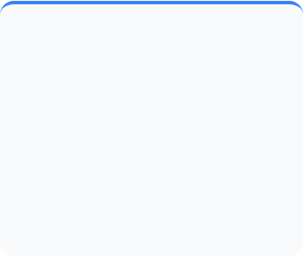
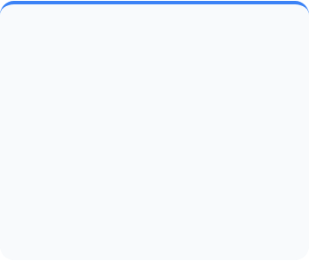
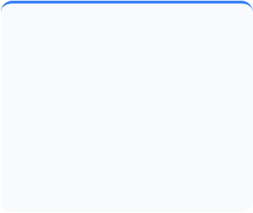



SYSTEM STAKEHOLDERS
PMU Students
External Donors
System Admins
Primary users who can browse available inventory and request clothing items based on need.
Visitors and university staff who wish to contribute gently used items to the bank.
Authorized staff who approve donations, manage stock levels, and generate reports.

Slide 5
FUNCTIONAL REQUIREMENTS
Registration: Secure account creation for all users.
Search: Filtering items by type, size, and category.
Authentication: Secure login and session management.
Admin Approval: Dashboard for item verification.
Request System: Simple "one-click" request workflow.
Donation Entry: Submission forms for item drop-offs.
Reporting: Status tracking for donors and students.
Inventory: Real-time visual catalog browsing.

Slide 6



NON-FUNCTIONAL STANDARDS
Security
Performance
Usability
Protection of user data and strict role-based access control for admin pages.
Optimized image loading for the inventory grid to ensure smooth browsing.
Clean, minimalist interface following modern UI/UX principles for PMU users.

Slide 7
PART 02
System Design

Slide 8
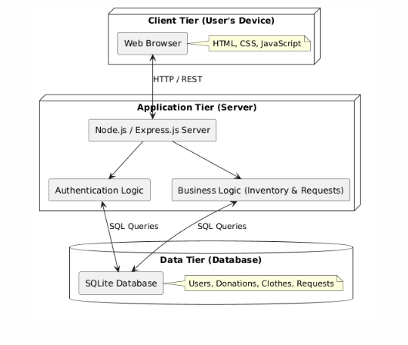
SYSTEM ARCHITECTURE
3-Tier Model
Our platform utilizes a Client-Server architecture. The Express.js backend acts as the bridge between the browser and the database layer.
This ensures that logic is centralized while the frontend remains lightweight and fast.

Slide 9


STRUCTURAL DESIGN
Database ER Schema
UML Modeling
A relational schema using Primary and Foreign keys connects users to their activities, maintaining strict data integrity across the platform.
Classes like User, ClothingItem, and Donation define the Object-Oriented structure, ensuring encapsulation and clear relations.

Slide 10
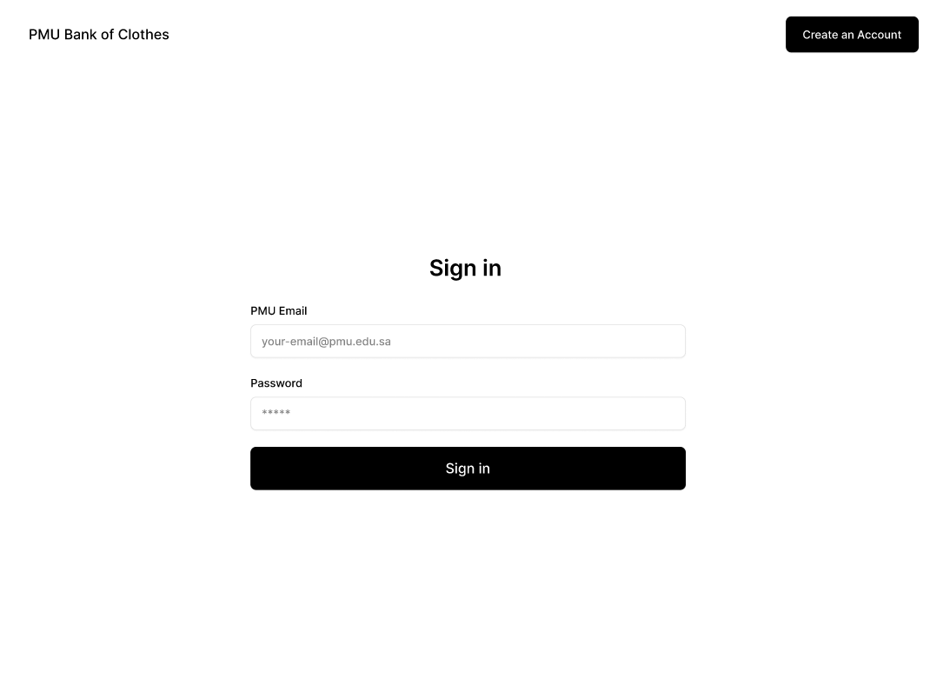
FIGMA PROTOTYPE
User Experience Flow
A high-fidelity mockup was developed to map out the entire user journey from the landing page to the administrative inventory tables using the tool Figma.
The design focuses on a clean, grid-based layout that simplifies the complex task of inventory management.

Slide 11

DEVELOPMENT & CODE
Implementation Details
The "Create Account" feature was implemented using Node.js and Express. It features server-side validation for PMU emails.
Public Repository Hosted on GitHub

Slide 12
Thank You!
PMU Bank of Clothes - Course Project
Principles of Software Engineering | GEIT 3351

Slide 13



IMAGE SOURCES
https://media.istockphoto.com/id/1307266201/vector/clothing-donation-box-isolated-on-white-background-charity-donation-second-hand-things.jpg?s=612x612&w=0&k=20&c=ULStKdeqoUyJ5bgIqutV_M2KuoZTYoHZRLMYbz92qog=
Source: www.istockphoto.com
https://cdn.processon.io/admin/knowledge/article_content_img/67ecf9cf45b96a5aedca958c.png
Source: www.processon.io
https://github.blog/wp-content/uploads/2025/04/darklight.png?fit=1600%2C750
Source: github.blog

